Slide 2
Going for better gaincal results
Suspect that contributing factor to inaccuracy of gain calibration is the fitting algorithm
Tried doing an interpolation on the underlying Vcal vs. ADC graph instead of a fit
(this is from SPS data: untrimmed detectors)

Slide 3
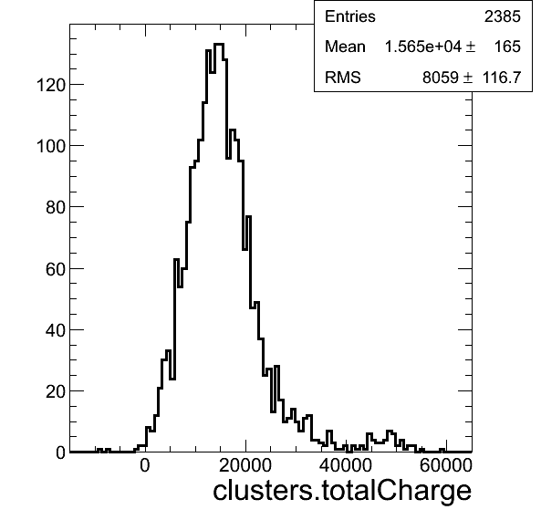
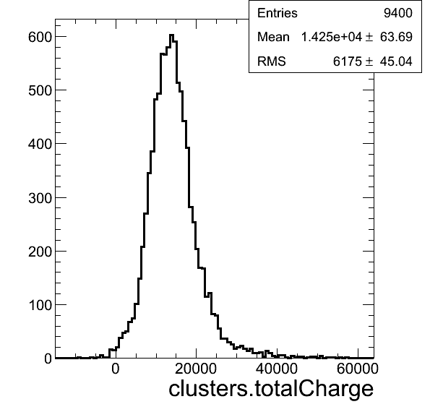
Before
No B
3T
Required exactly 2 hits along Y

Slide 4
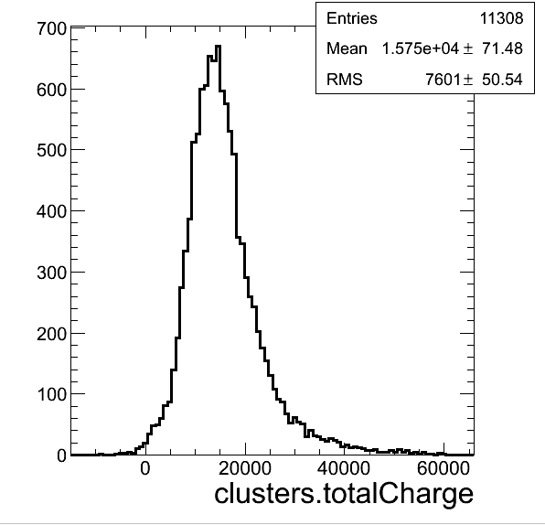
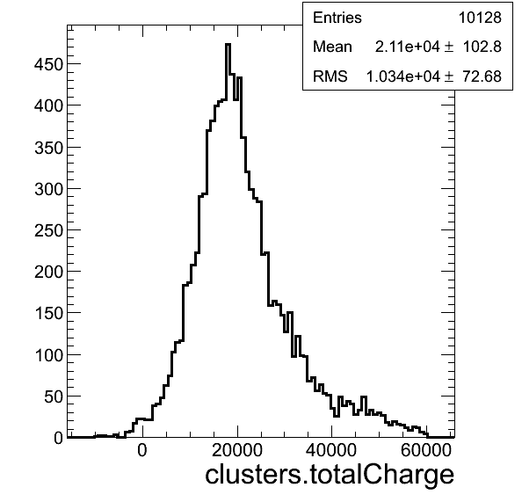
Before
No B
3T
Required >= 2 hits along Y

Slide 5
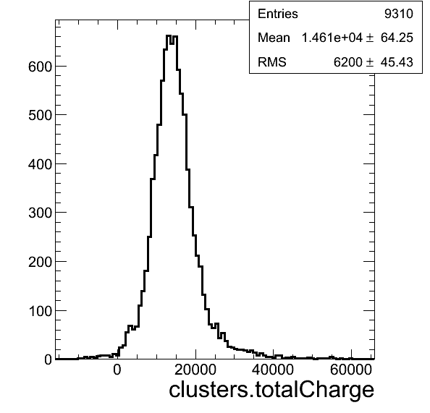
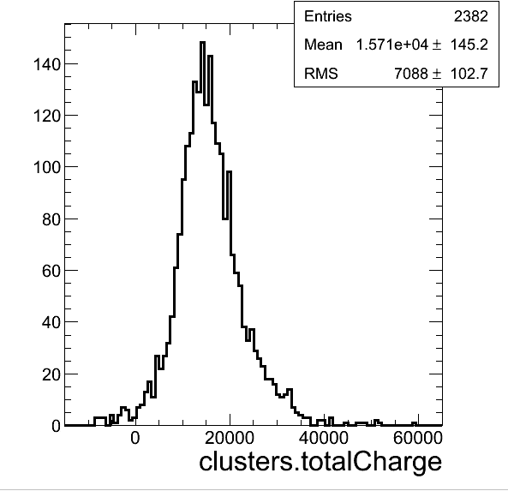
After
No B
3T
Nhits == 2
Still not perfect

Slide 6
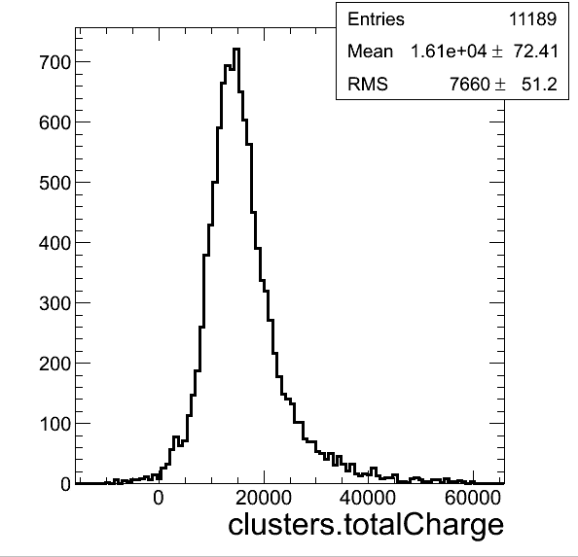
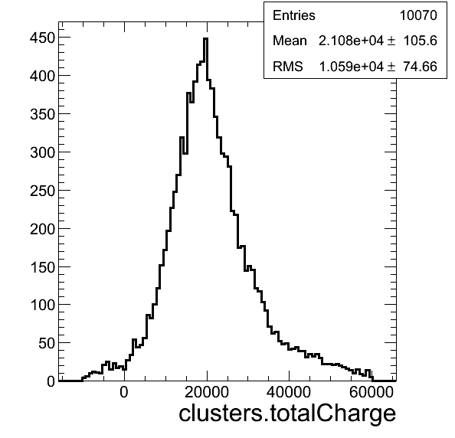
After
No B
3T

Slide 7
After
From reduced

Slide 8
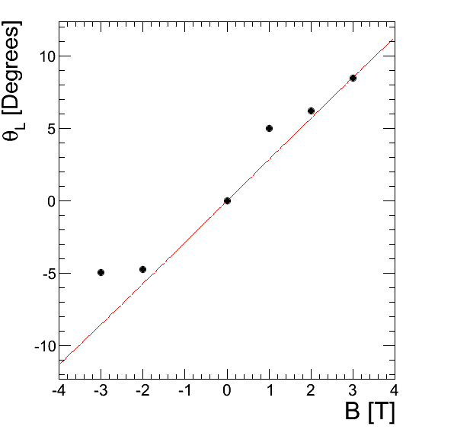
After
Red: Theory (based on mobility in H. Kagan’s Paper

